Slide 1
Recent advances in the Management of Thalassaemia

Slide 2
Target for the future
Cure for Thalassaemia
Stem Cell Transplantation
Bone Marrow derived Stem Cells
Umbilical Cord Blood Stem Cells
Peripheral Blood Stem Cells
Gene Therapy
Less transfusion dependence
Easier, safer and more effective Chelation Therapy

Slide 3
Haematopoietic Stem Cell Transplantation
Standard therapy – Selection of HLA matched donor or unit, intensive chelation
Conditioning of the patient – Hickmann catheterization, myeloablative chemotherapy, antibiotics, antifungals and antivirals, transfusion support.
Collection of HSC and processing
Infusion of the HSC via peripheral venous access
Initiation of Colony Stimulating Factor and continuation of antibiotics, antifungals and antivirals, transfusion support.
Recovery of Neutrophils > 1000/μL, date of engraftment
Discontinuation of transfusion support, contemplating engraftment, establishment of Donor/Recipient Chimera, continuation of Chelation

Slide 4
Newer approaches in HSCT
HSCT following reduced intensity conditioning – Matched sibling Donor / matched family-related UCB donor
Matched unrelated HSCT
Non-myeloablative Haploidentical HSCT
Non-myeloablative mobilized peripheral blood HSCT
Unrelated UCB following HLA-haploidentical HSCT
UCB derived ex vivo expanded stem and progenitor cells

Slide 5
Gene Therapy
Defect in Beta Globin gene loci

Slide 6
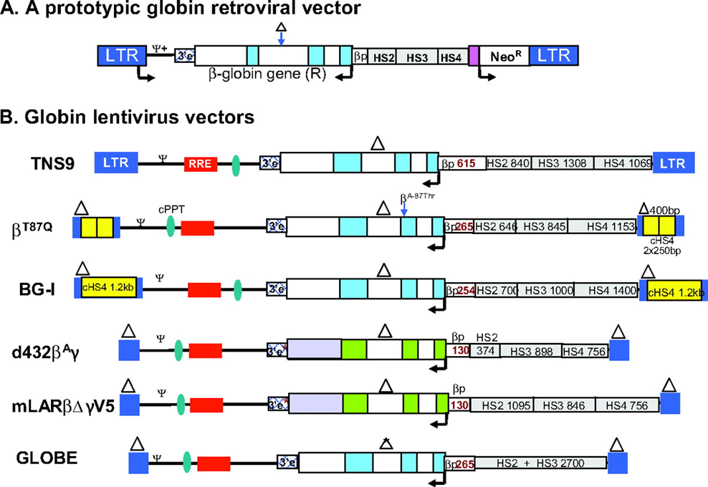
Beta –globin gene addition

Slide 7
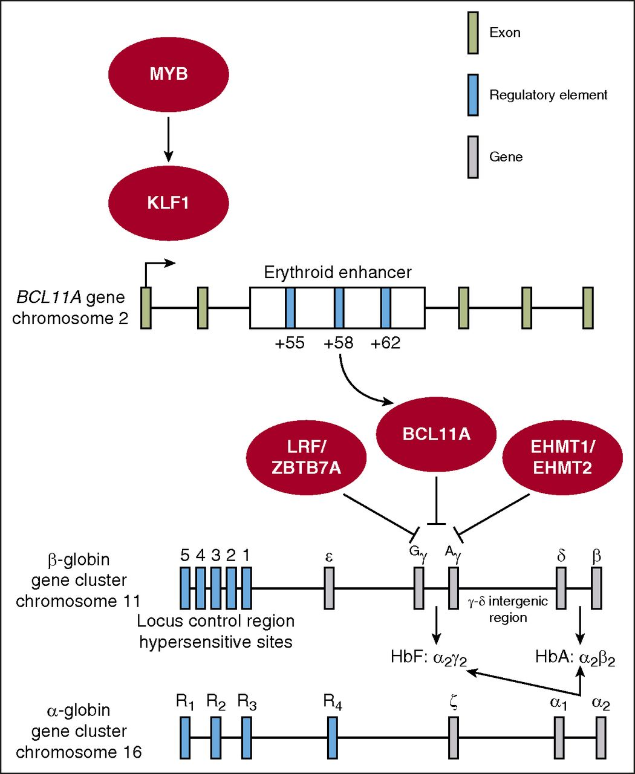

Slide 8
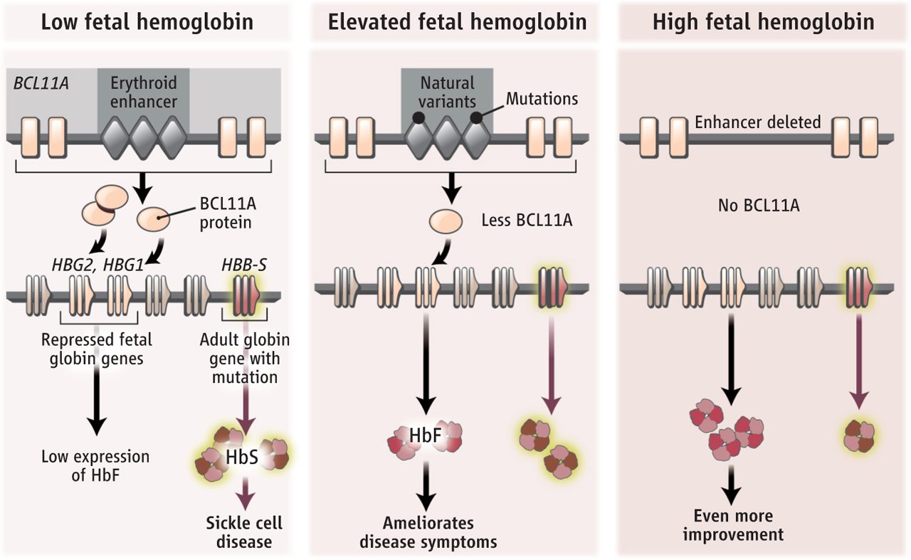

Slide 9
Induction of Fetal Haemoglobin
Gene modification
Lentivirus carrying sequences of miRNAs inhibiting BCL11A
Antisense oligonucleotides BCL11A inactivator
ZFN-driven activation of the Promoter of γ-globin gene
ZFN-driven BCL11A enhancer ablation
CRISPR-Cas9 mediated BCL11A enhancer inactivation

Slide 10
Gene correction
Zinc Finger Nuclease (ZFN)
Transcription Activator-Like Effectors (TALEN)
Clustered Regularly Interspaced Short Palindromic Repeats - CRISPR associated (CRISPR-Cas9) – Gene Editing

Slide 11
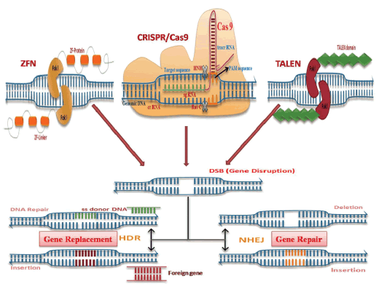

Slide 12
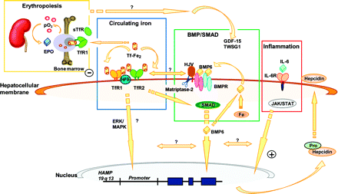
Erythroid Maturation factor activity web

Slide 13
Erythroid Maturation agents
Sotatercept (ACE-536)
Lupatercept (ACE-011)
Ligand trap TGF-β superfamily, administered as s/c dose, every 21 days, Phase 2 and phase 2 extension study going on.
Acceleron pharma and Celgene Corporation
RAP-011 inhibit expression of GDF11 > reduction of apoptosis of immature erythroblasts through Fas-Fas ligand pathway and RAP -536 reduced activation of SMAD2/3 pathway.
Ruxolitinib (INC424)
JAK inhibitor, Oral tablet.
Increases HbF production, reduced ineffective erythropoiesis and splenomegaly after short term administration of JAK2 inhibitor.
Phase 2 trial to commence, Novartis Pharma, Open study

Slide 14
SOTATERCEPT & LUSPATERCEPT
Dose | Increase | % patients | > 20% reduction in Transfusion | LIC reduction | Adverse effects Asthenia, myalgia, headache, bone pain
0.3 mg/kg | 1 gm/dl | 67% | 33% | + | + (10%)
0.75 mg/kg | 1 gm/dl | 100% |  | +++ | +
0.5 mg/kg | 2 gm/dl | 33% | 50% | + | +
0.75 mg/kg | 2 gm/dl | 50% | 67% | ++ | +
Phase 3 trial BELIEVE study is going on

Slide 15
Drug | Mechanism | Material | Reference | Institution / Developer
Rapamycin | mTOR inhibitor Antioxidant effect, Foxo3 Activation | Erythroid progenitors Thalassaemic mice | Zhang X et al, AJH, 2014;89:954-953 27 Pecoraro A, et al, Haemoglobin, 2015;39:225-229 34 | Icahn School of Medicine, Mount Sinai, NY Dept of Oncology, Ospedali Rinuti, Palermo, Italy
Resveratrol | Antioxidant effect, Foxo3 activation | Thalassaemic mice | Franco SS et al Haematologica, 2014;99:267-275 35 | Dept. of Medicine, University of Verona, Italy
Salubrinal | Inhibition of elF2aP dephosphorylation, hemichrome reduction HbF induction | Erythroid progenitors form Beta thal mice Differentiating human CD34+ cells | Suragni RN, et al, Blood 2012, 119:5276-5284 39 Hahn CK, Blood, 2014,124:2730-2734 41 | Harvard MIT Cambridge MA Dept of Toxicol & Phar Geisel School of Med
Exogenous transferrin | TfR1 down regulation, improvement of erythroid terminal differentiation | Thalassaemic mice | Li H et al, 57th ASH Annual Meeting, 2015 # 754 70 | New York Blood Center
Minihepcidins | Hepcidin Up regulation | Thalassaemic mice | Casu C et al. 55th ASH Annual Meeting, 2013 # 431 69 | Weil Cornell Medical College
Leptomycin B | XPO1 inhibitors, improvement of terminal differentiation of erythroids | Erythroid progenitors from Beta TM patients | Guillem F et al, 57th ASH Annual Meeting, 2015 # 2368 50 | Laboratorie INSERM, Paris, France

Slide 16
Conclusion
Inefficient erythropoiesis is the main mechanism underlying the pathology of anaemia and all the complications in Thalassaemia.
Recent research has identified key sequences, revealing novel modulators, which could address the ineffective erythropoiesis .
TGF-β family member inhibitors – have shown encouraging results in Phase 2 trials, regardless of the severity and Phase 3 has been initiated.
JAK2 inhibitors have already been started on Phase 2 clinical trial.
It can now safely be said that HSCT which is the mainstay of cure with Gene therapy, we may never have to subject another Thalassaemic individual to immunomodulatory +/- Myeloablative related morbidity or mortality.

Slide 17
Do not lose hope
The permanent solution is just round the corner
Thank you

